Slide 1
PRESS RELEASE
GHANA, September 2022
CONSUMER PRICE INDEX AND INFLATION
12th September 2022

Slide 2
In this release, we present:
Definition and Measurement of Consumer Price Index (CPI) and Rate of Inflation
Background to the new series
CPI and Rate of Inflation for September 2022
Dominant Divisions of Rate of Inflation for September 2022
Disaggregation of Rate of Inflation for September 2022
Highlights of CPI and Rate of Inflation for September 2022

Slide 3
Definition and measurement of CPI and rate of inflation (1/3)
CPI measures changes in the price of a fixed basket of goods and services purchased by households
The assumption is that the basket is purchased each month, hence as price changes each month, the total price of the basket will also change
The rate of inflation is the relative change in CPI between periods
Inflation is reported year-on-year (annual inflation) and month-on-month (monthly inflation), and granulated to determine regional and commodity type and source of inflation
2
2

Slide 4
Definition and measurement of CPI and rate of inflation (2/3)
CPI does not measure price levels
The measures of CPI and inflation are based on the Consumer Price Index Manual: Concepts and Methods
Data (market readings) are captured monthly
Key variables are prices, quantities and expenditure weights of items
Price reference year for the New Series is 2021 (2021 = 100)
3

Slide 5
Transitioning from 10 to 16 Administrative Regions
Computational Considerations
Re-adjustment of regional weights
Replacement and inclusion of markets and outlets
Variation in price reference year
Representativeness of items across regions
4
Notes:
On year-on-year basis, the difference between Food inflation (37.8%) and Non-food (36.8%) was 1.0 percentage points.
On month-on-month basis, food inflation (2.2%) records a lower rate than non-food (1.7%), leading to 0.5 percentage point difference.
The percentage point difference between inflation for imported items (40.7%) and locally domestic items (35.8%) was 4.9

Slide 6
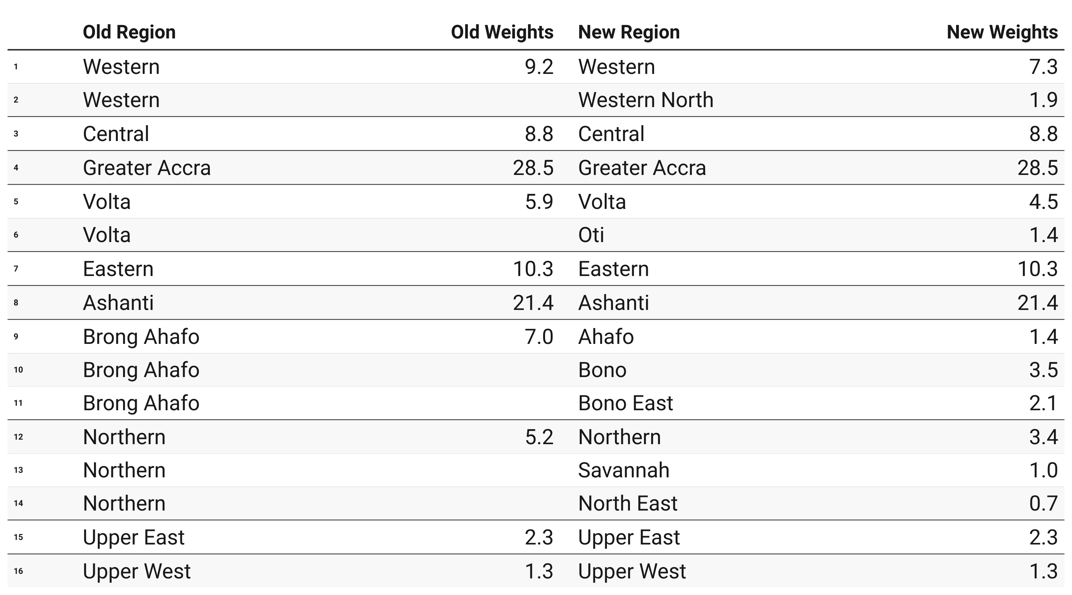
Variation in Regional Weights
5
Notes:
Western Region recorded highest food inflation (47.0%) and Eastern Region, the highest non-food inflation (42.0%). Eastern Region recorded the overall highest inflation (41.0%) followed closely by Western Region (40.2%) and Greater Accra Region (39.3%).

Slide 7
Definition and measurement of CPI and rate of inflation (3/3)
Prices are collected for 47,877 products every month from 16 regions.
Price collection is done in 57 markets
Prices are collected from about 8,337 outlets.
Products are ordered in a hierarchy of 13 Divisions, 44 Groups, 98 Classes, 156 Subclasses and 307 Items.
Every Item can only be part of one Subclass, and every Subclass can only be part of one Class, etc.
6

Slide 8
Consumer Price Index and Rate of Inflation for Sept. 2022
CPI for September 2022 based on the new series was 140.6
Year-on-year inflation rate for September 2022 based on the 16 administrative regions was 37.2%
This means that in the month of September 2022 the general price level was 37.2% higher than September 2021
Month-on-month inflation between August 2022 and September 2022 was 2.0%
Month | CPI | Inflation |  | Quarterly Averages
 |  | Monthly | Yearly | Quarterly Averages
Sept-2021 | 102.4
Aug-2022 | 137.9
Sept-2022 | 140.6 | 2.0% | 37.2%
7

Slide 9
Disaggregation of September 2022 rate of inflation
Food inflation (0.437) was 37.8%
Month-on-month Food inflation was 2.2%.
Non-food Inflation (0.563) was 36.8%
Month-on-month Non-Food inflation was 1.7%
Inflation for locally produced items was 35.8%
Inflation for imported items was 40.7%
8
Notes:
On year-on-year basis, the difference between Food inflation (37.8%) and Non-food (36.8%) was 1.0 percentage points.
On month-on-month basis, food inflation (2.2%) records a lower rate than non-food (1.7%), leading to 0.5 percentage point difference.
The percentage point difference between inflation for imported items (40.7%) and locally domestic items (35.8%) was 4.9

Slide 10
Disaggregation of year-on-year inflation by Division (1/2)
Divisions | Y-o-Y | M-o-M
Housing, water, electricity, gas and other fuels | 68.8 | 2.0
Furnishings, household equipment and routine household maintenance | 51.5 | 3.5
Transport | 46.8 | 0.9
Personal care, social protection and miscellaneous goods and services | 42.6 | 4.1
Food and Non-Alcoholic Beverages | 37.8 | 2.2
Recreation, sport and culture | 36.3 | 2.2
Clothing and footwear | 28.7 | 3.5
Health | 22.8 | 2.3
Alcoholic Beverages, Tobacco & Narcotics | 22.0 | 1.8
Information and communication | 14.9 | 2.2
Insurance and financial services | 13.6 | 0.0
Restaurants and accommodation services | 11.1 | -2.5
Education | 8.3 | 0.5
9
Notes:
Five divisions record inflation rates higher than the national average (37.2%).
Wide disparity is observed across the 13 divisions with Y-o-Y Housing, water electricity, gas and other fuels leading by 68.8%, followed by Furnishings, household equipment and routine household maintenance (51.5%), Transport 46.8% and Personal care, social protection and miscellaneous goods and services (42.6% and Food and Non-Alcoholic Beverages (37.8%). The division with the highest Y-o-Y inflation (Housing, water electricity, gas and other fuels) is more than eights times as high as the lowest (Education Service (8.3%)).
On a month-on-month basis, Personal care, social protection and miscellaneous goods and services records the highest inflation (4.1%) and the lowest (Restaurants and Accommodation Services) records a deflation of 2.5%

Slide 11
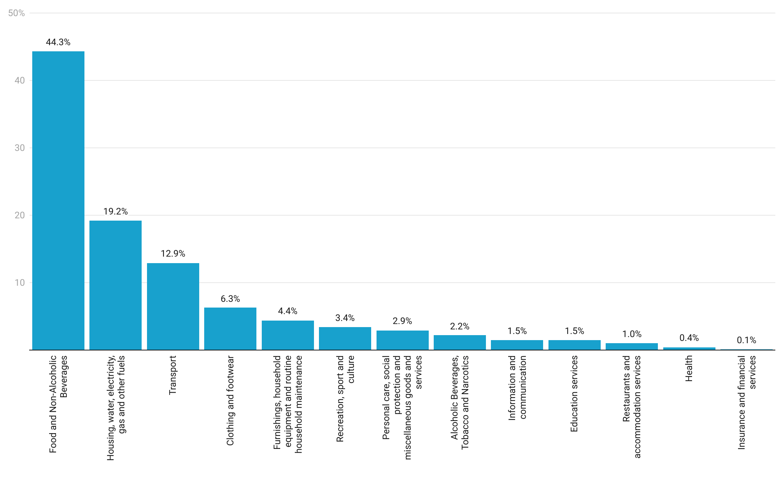
Shares Rate of Inflation Across Divisions
10
Notes:
Western Region recorded highest food inflation (47.0%) and Eastern Region, the highest non-food inflation (42.0%). Eastern Region recorded the overall highest inflation (41.0%) followed closely by Western Region (40.2%) and Greater Accra Region (39.3%).

Slide 12
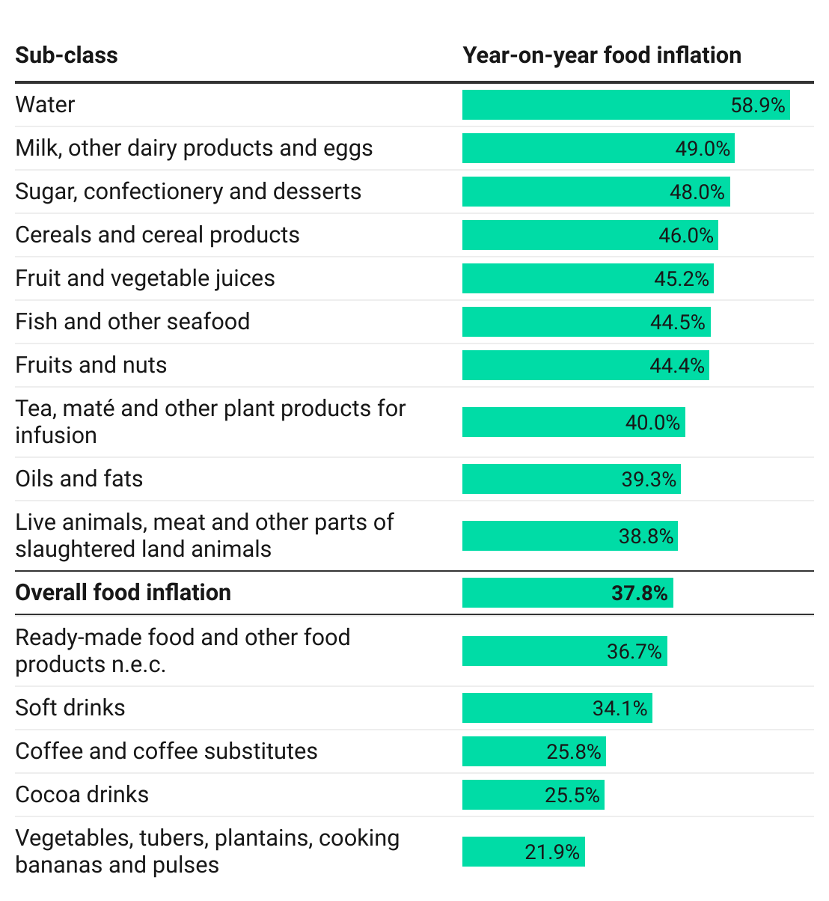
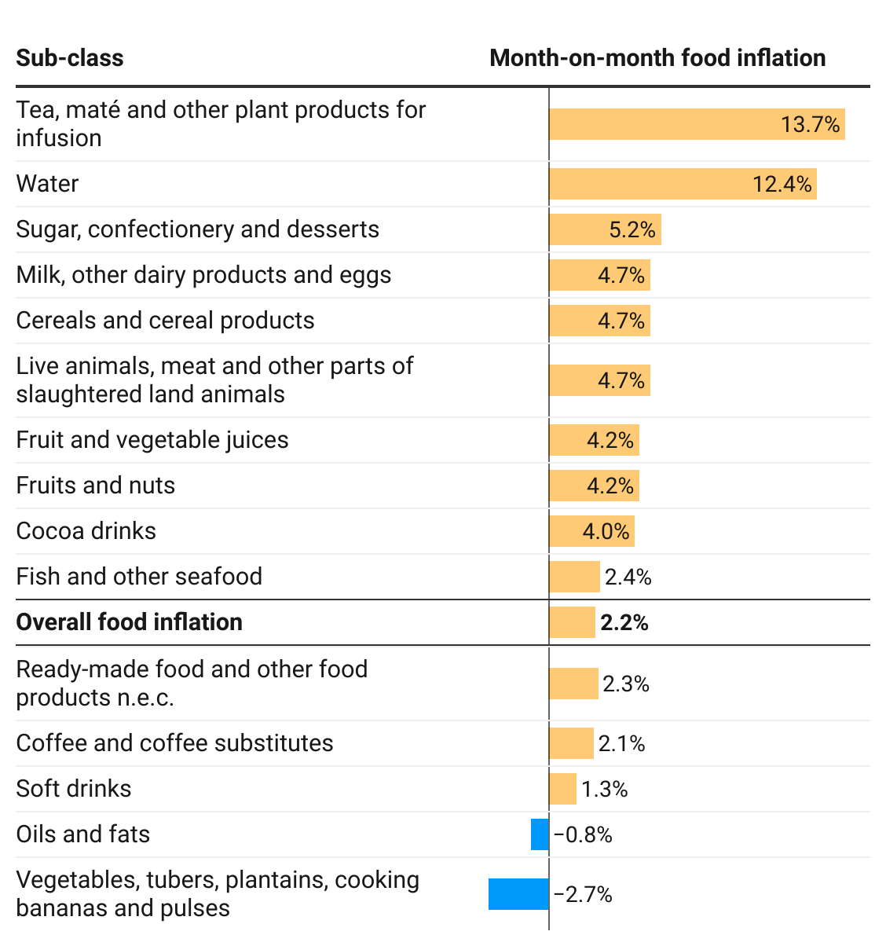
Disaggregation of YoY and MoM Food-inflation by Subclass
11
Notes:
Focusing on food inflation on a year-on-year basis (37.8%) for September 2022, 10 subclasses recorded higher rates. This was distantly led by Water (58.9%) followed by Milk, Other Dairy Products and Eggs (49.0%) and Sugar Confectionery and Desserts(48.0%). Also in the case of month-on-month food inflation (2.2%) 10 subclasses record rates higher than the national average.
On a month-on-month basis deflation of 2.7% was recorded for vegetables, tubers, plantains and pulses

Slide 13
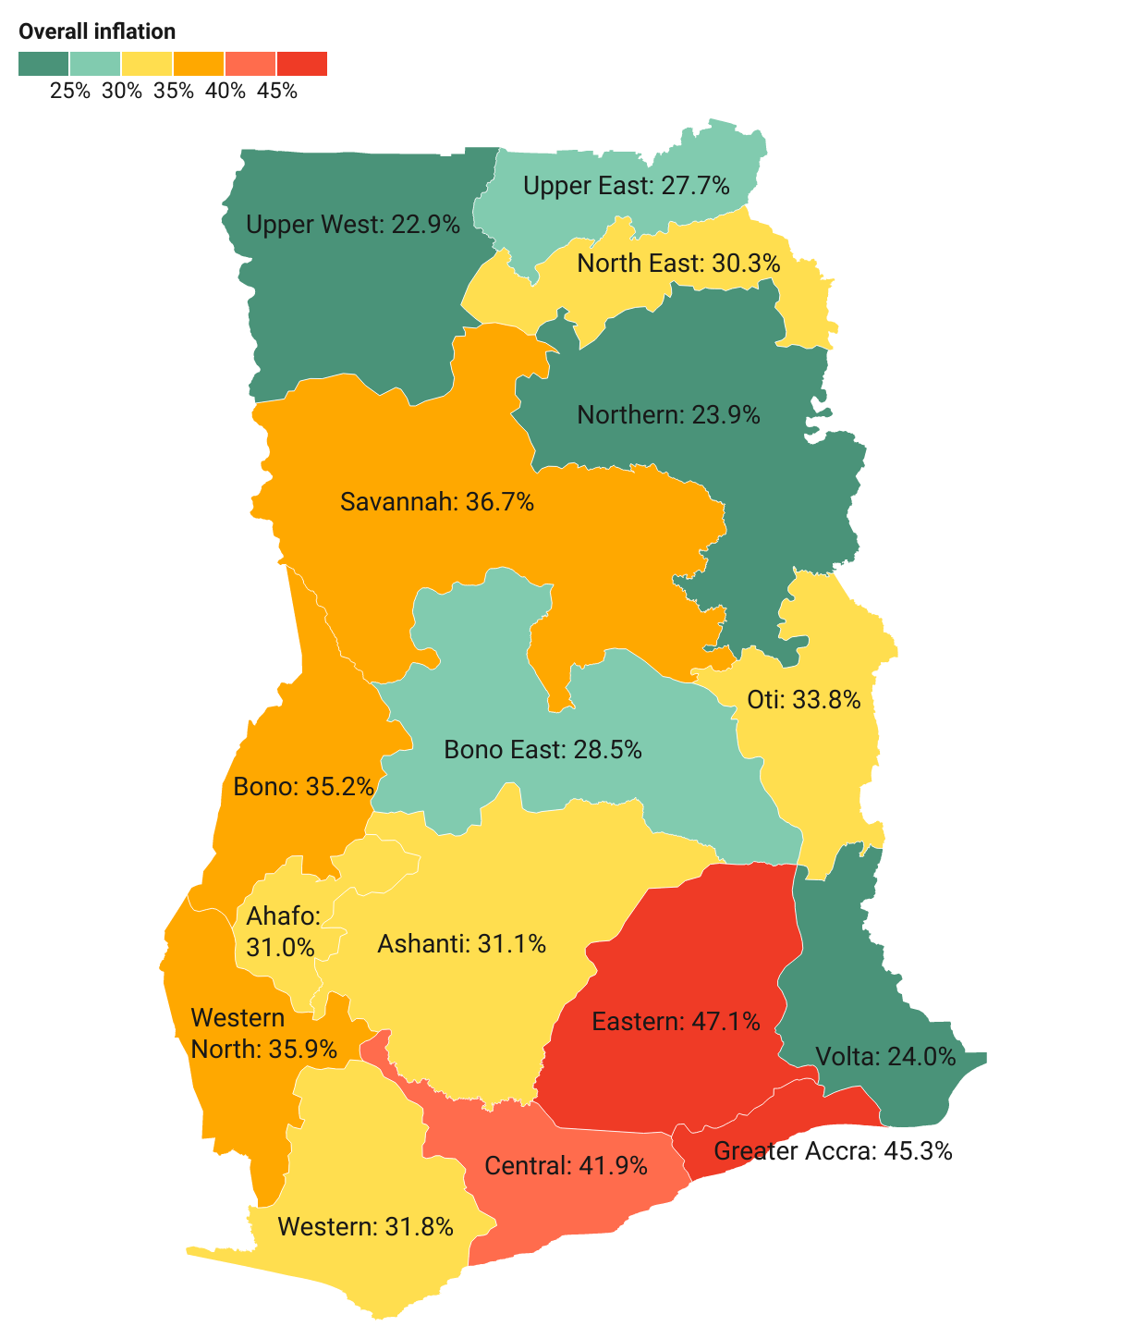
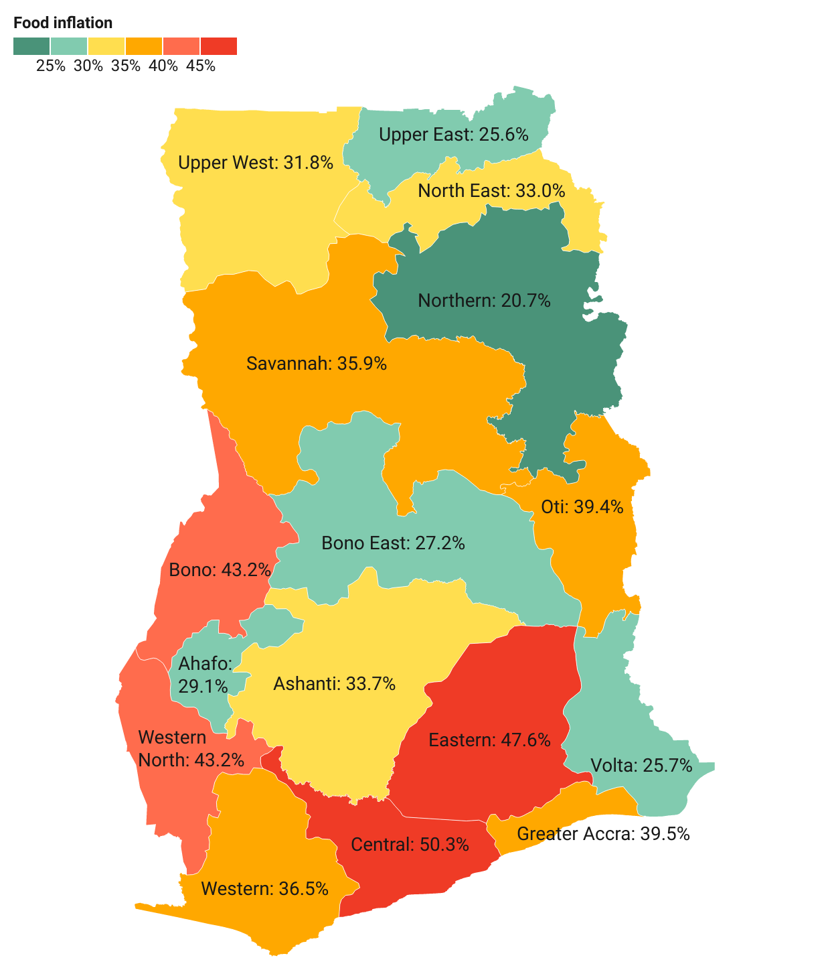
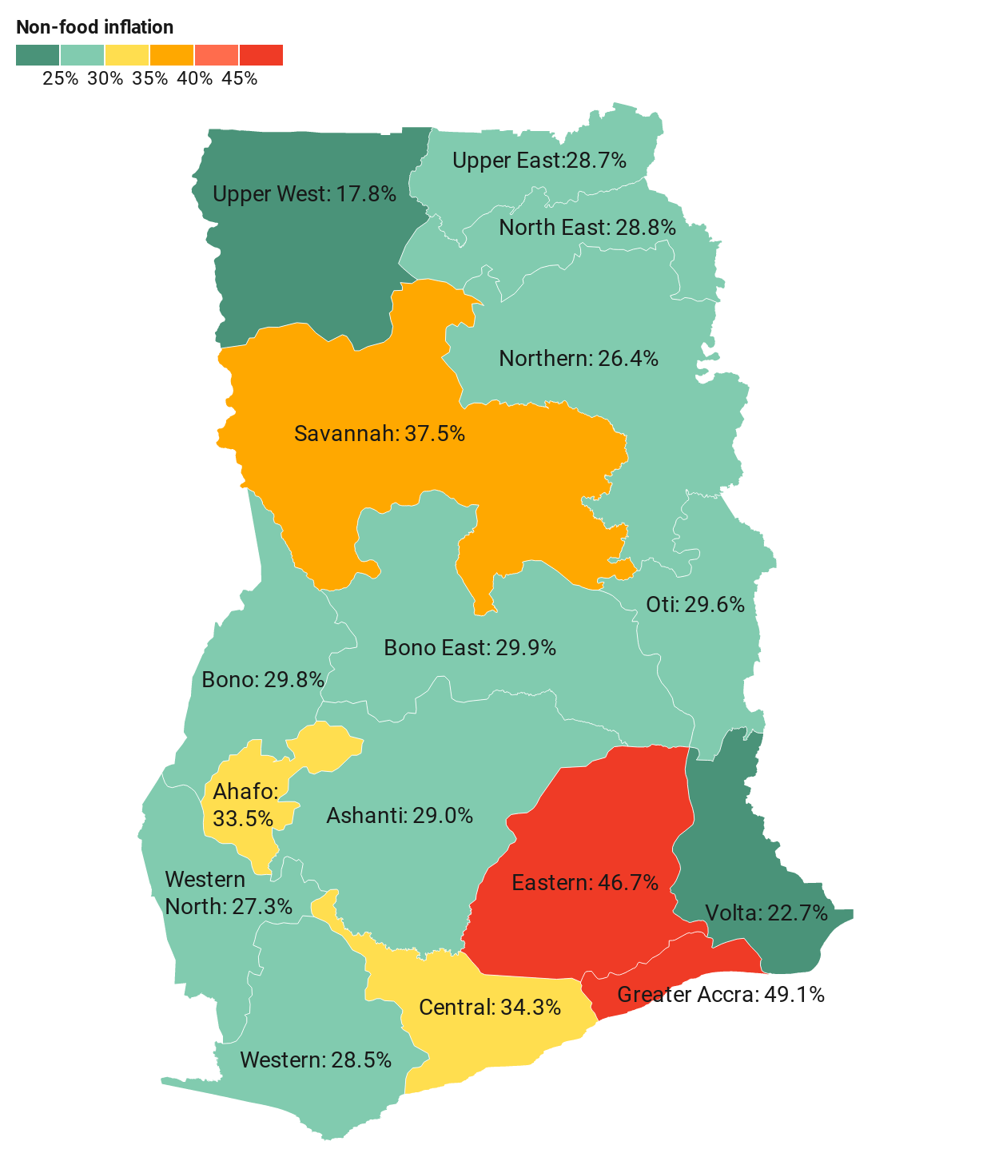
September 2022 regional rates of inflation
12
Notes:
Central Region (50.3%) recorded the highest food inflation while Greater Accra recorded the highest non-food inflation (49.1%)
Easter Region had the overall highest inflation of 47.1%

Slide 14
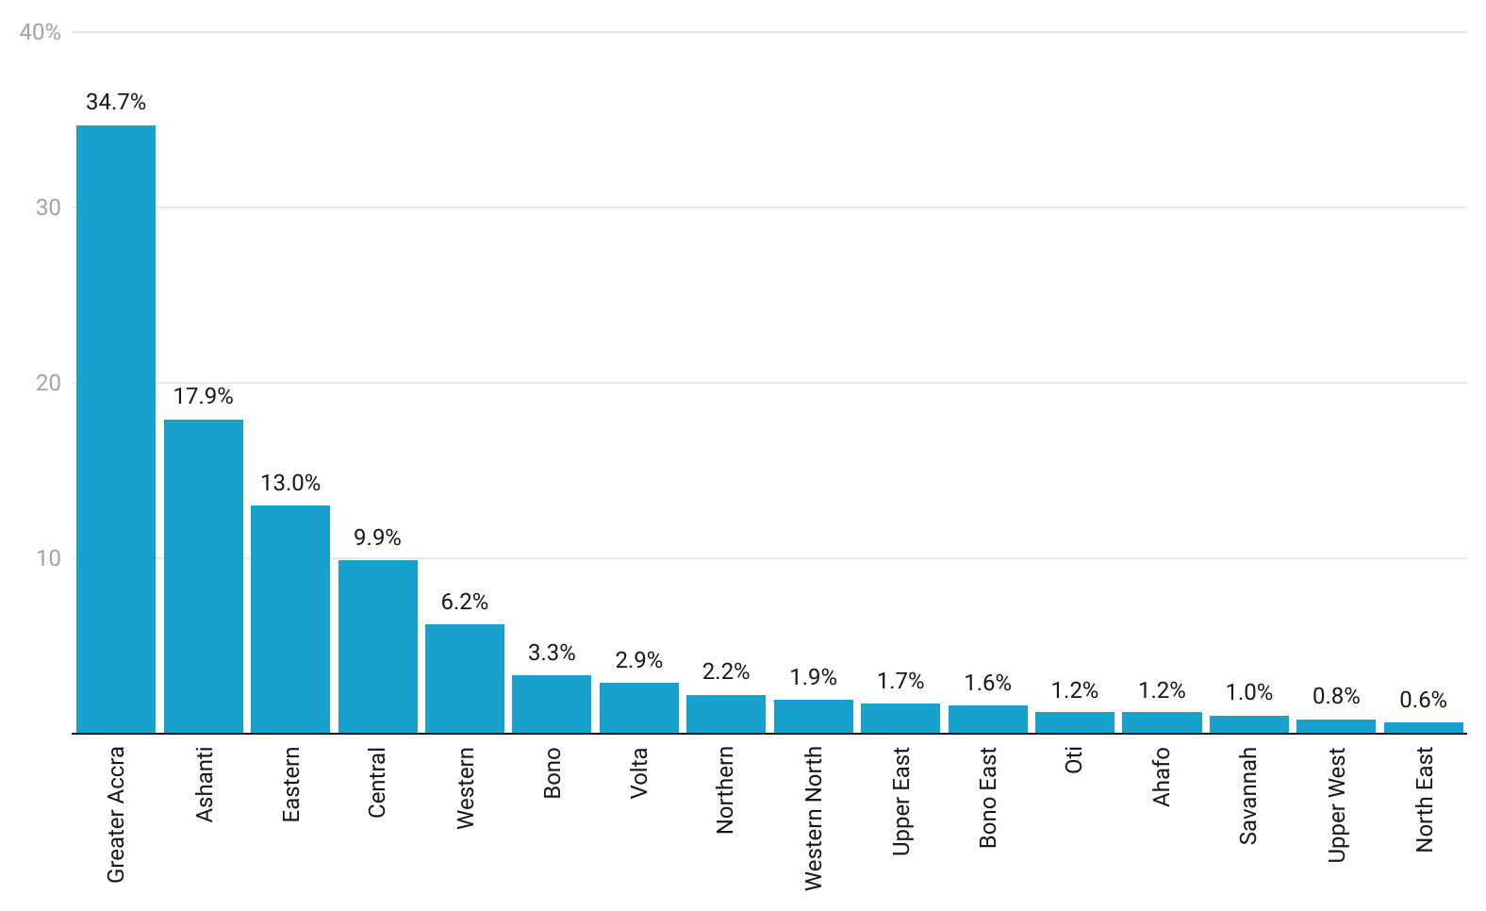
Regional Shares of Inflation
13
Notes:
Western Region recorded highest food inflation (47.0%) and Eastern Region, the highest non-food inflation (42.0%). Eastern Region recorded the overall highest inflation (41.0%) followed closely by Western Region (40.2%) and Greater Accra Region (39.3%).

Slide 15
Disaggregation of inflation in Eastern and Central Regions for September 2022
14
Notes:
Transport (68.7%) recorded the highest rate of inflation in the Eastern Region, for food inflation in the Western Region, Fish and Other Seafood had the highest rate of inflation of 64.0%.

Slide 16
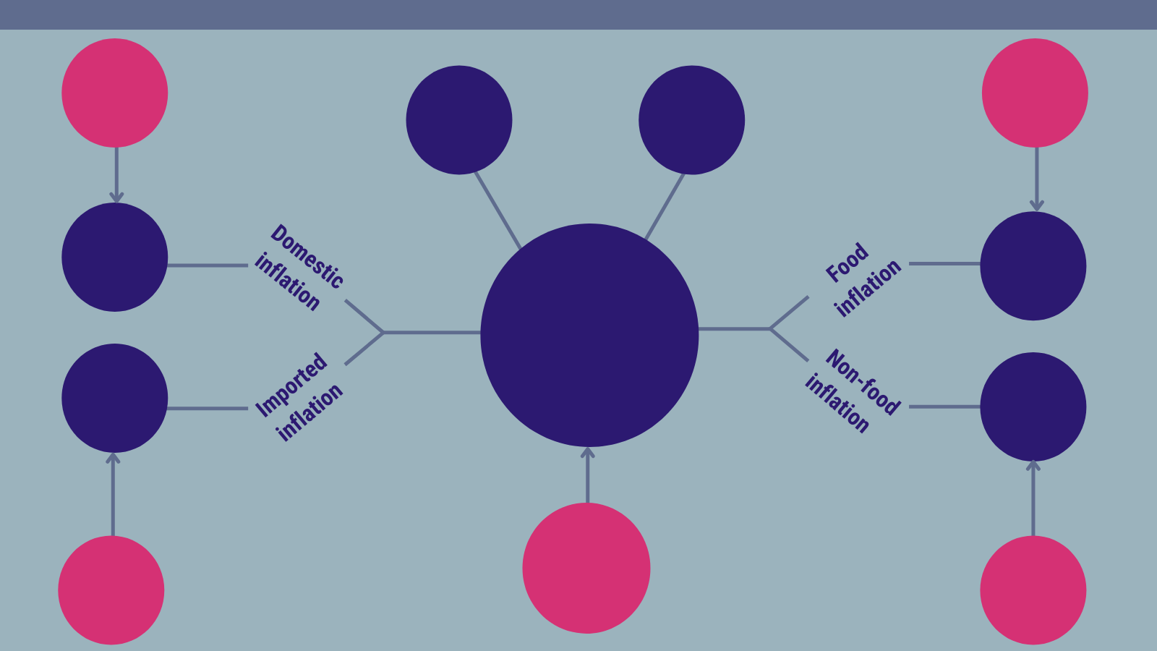
Highlights (1/2)
47.1%
Highest regional inflation rate
(Eastern)
22.9%
Lowest regional inflation rate
(Upper West)
35.8%
37.8%
37.2%
Year-on-year inflation
September 2022
40.7%
36.8%
Notes:
Y-o-Y inflation varied upwardly by 2.2 percentage points between August (31.7%) and September (33.9%) 2022.

Slide 17
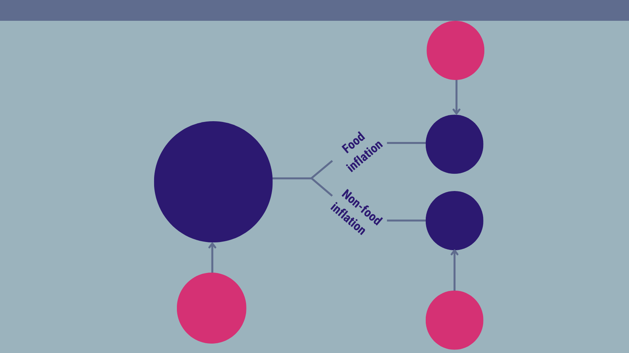
Highlights (2/2)
2.0%
Month-on-month inflation
September 2022
2.2%
1.7%

Slide 18
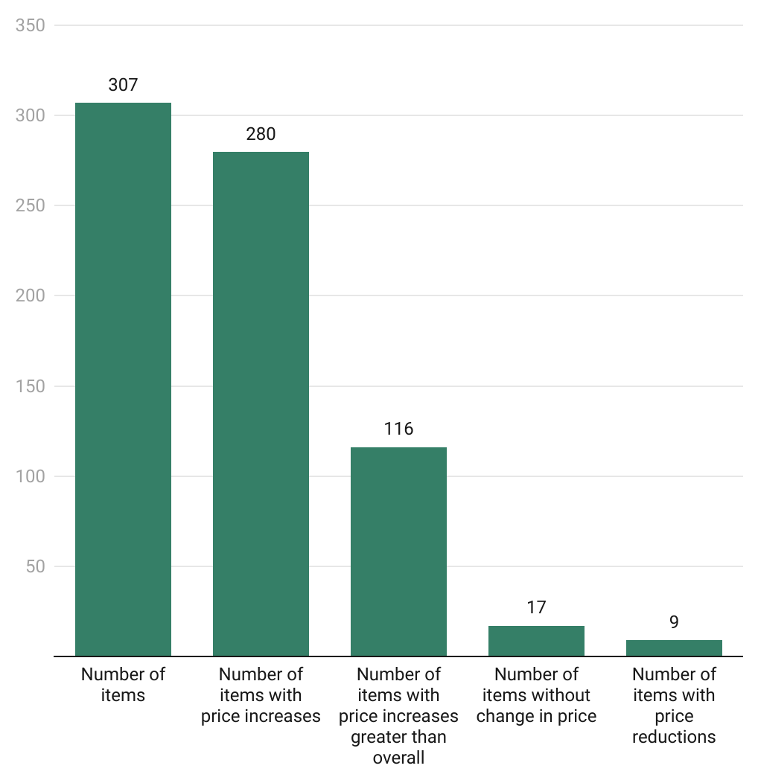
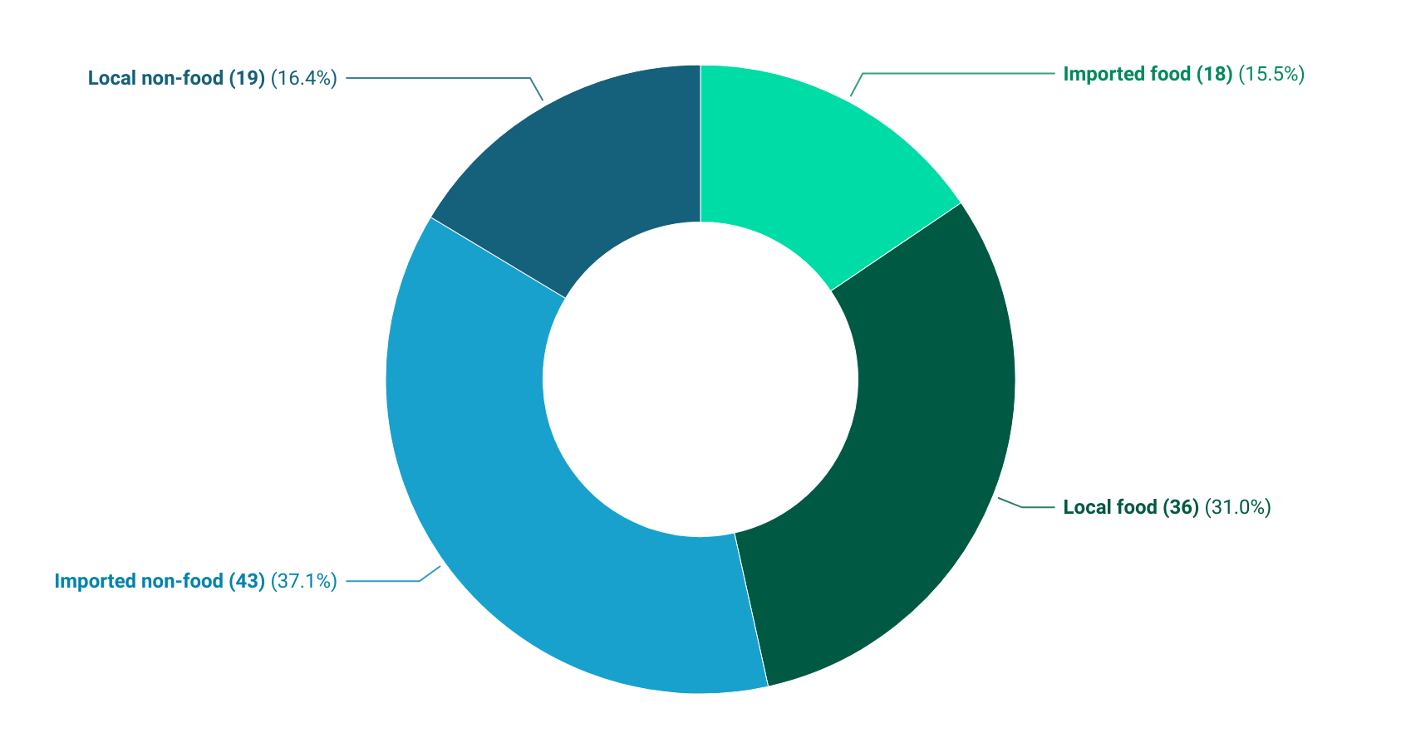
Additional Policy Considerations (1/2)
17
Notes:
More than 90 percent of the items recorded an increase in price

Slide 19
End of Press Release for September 2022 Consumer Price Index
For enquiries, please contact:
https://statsghana.gov.gh/gssmain/fileUpload/Price%20Indices/CPI_Technical_Guide_v5_Published_14102020.pdf
Mr. John F.K. Agyaho
(Head, Price Statistics, GSS)
john.agyaho@statsghana.gov.gh

Slide 20
CLARIFICATIONS ON THE COMPUTATION AND INTERPRETATION OF CPI AND RATE OF INFLATION
Non-comparability of the Steve-Hanke PPP- and CPI-based measures of consumer inflation
Data sources
Scope of data
Country relevance
Scope of items
Interpretation of indices and percentage changes
Between January and June 2022 Food Inflation increased by 22%
Month | CPI
Jan_22 | 141.9
Feb_22 | 146.5
March_22 | 153.1
April_22 | 162.0
May_22 | 168.6
June_22 | 172.4
July_22 | 178.1
Aug_22 | 181.3
19
Notes:
On year-on-year basis, the difference between Food inflation (37.8%) and Non-food (36.8%) was 1.0 percentage points.
On month-on-month basis, food inflation (2.2%) records a lower rate than non-food (1.7%), leading to 0.5 percentage point difference.
The percentage point difference between inflation for imported items (40.7%) and locally domestic items (35.8%) was 4.9

Slide 21
Consumer Price Index and Inflation
September 2022

